Slide 1
Introduction to Networking
CT043-3-1 & Version VE1
Build a Small Network

Slide 2
Build a Small Network
Notes:
Cisco Networking Academy Program
Introduction to Networks v7.0 (ITN)
Module 17: Build a Small Network

Slide 3
. Topics and Structure of the lesson
Topic Title | Topic Objective
Devices in a Small Network | Identify the devices used in a small network.
Small Network Applications and Protocols | Identify the protocols and applications used in a small network.
Scale to Larger Networks | Explain how a small network serves as the basis of larger networks.
Verify Connectivity | Use the output of the ping and tracert commands to verify connectivity and establish relative network performance.
Host and IOS Commands | Use host and IOS commands to acquire information about the devices in a network.
Troubleshooting Methodologies | Describe common network troubleshooting methodologies.
Troubleshooting Scenarios | Troubleshoot issues with devices in the network.
Notes:
3
17.0.2

Slide 4
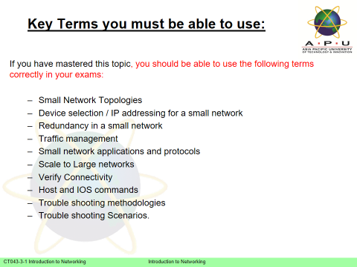
Contents & Structure

Slide 5
Devices in a Small Network
Notes:
17 - Build a Small Network
17.1 – Devices in a Small Network

Slide 6
Devices in a Small Network Small Network Topologies
The majority of businesses are small most of the business networks are also small.
A small network design is usually simple.
Small networks typically have a single WAN connection provided by DSL, cable, or an Ethernet connection.
Large networks require an IT department to maintain, secure, and troubleshoot network devices and to protect organizational data. Small networks are managed by a local IT technician or by a contracted professional.
Notes:
17 – Build a Small Network
17.1 – Devices in a Small Network
17.1.1 – Small Network Topologies

Slide 7
Devices in a Small Network Device Selection for a Small Network
Like large networks, small networks require planning and design to meet user requirements. Planning ensures that all requirements, cost factors, and deployment options are given due consideration. One of the first design considerations is the type of intermediary devices to use to support the network.
Factors that must be considered when selecting network devices include:
cost
speed and types of ports/interfaces
expandability
operating system features and services
Notes:
17 – Build a Small Network
17.1 – Devices in a Small Network
17.1.2 – Device Selection for a Small Network

Slide 8
Devices in a Small Network IP Addressing for a Small Network
When implementing a network, create an IP addressing scheme and use it. All hosts and devices within an internetwork must have a unique address. Devices that will factor into the IP addressing scheme include the following:
End user devices - The number and type of connections (i.e., wired, wireless, remote access)
Servers and peripherals devices (e.g., printers and security cameras)
Intermediary devices including switches and access points
It is recommended that you plan, document, and maintain an IP addressing scheme based on device type. The use of a planned IP addressing scheme makes it easier to identify a type of device and to troubleshoot problems.
Notes:
17 – Build a Small Network
17.1 – Devices in a Small Network
17.1.3 – IP Addressing for a Small Network

Slide 9
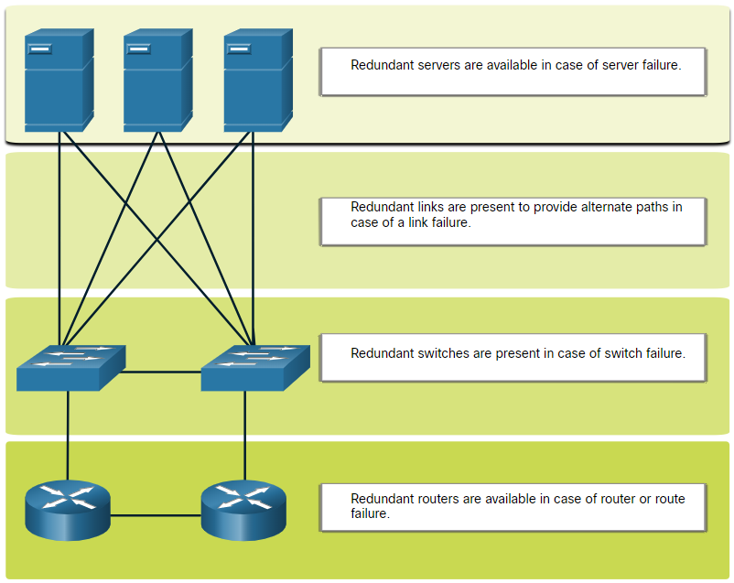
Devices in a Small Network Redundancy in a Small Network
In order to maintain a high degree of reliability, redundancy is required in the network design. Redundancy helps to eliminate single points of failure.
Redundancy can be accomplished by installing duplicate equipment. It can also be accomplished by supplying duplicate network links for critical areas.
Notes:
17 – Build a Small Network
17.1 – Devices in a Small Network
17.1.4 – Redundancy in a Small Network

Slide 10
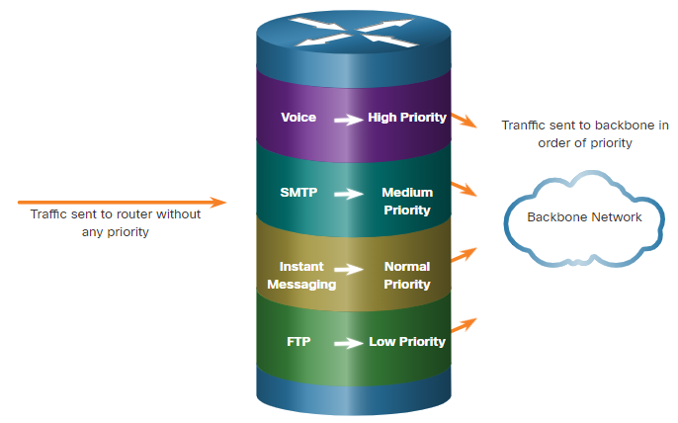
Devices in a Small Network Traffic Management
The goal for a good network design is to enhance the productivity of the employees and minimize network downtime.
The routers and switches in a small network should be configured to support real-time traffic, such as voice and video, in an appropriate manner relative to other data traffic. A good network design will implement quality of service (QoS).
Priority queuing has four queues. The high-priority queue is always emptied first.
Routers/Switches must support QoS
Notes:
17 – Build a Small Network
17.1 – Devices in a Small Network
17.1.5 – Traffic Management
17.1.6 – Check Your Understanding – Devices in a Small Network

Slide 11
Small Network Applications and Protocols
Notes:
17 - Build a Small Network
17.2 - Small Network Applications and Protocols

Slide 12
Small Network Applications and Protocols Common Applications
After you have set it up, your network still needs certain types of applications and protocols in order to work. The network is only as useful as the applications that are on it.
There are two forms of software programs or processes that provide access to the network:
Network Applications: Applications that implement application layer protocols and are able to communicate directly with the lower layers of the protocol stack.
Application Layer Services: For applications that are not network-aware, the programs that interface with the network and prepare the data for transfer.
Notes:
Network Applications
Applications are the software programs used to communicate over the network. Some end-user applications are network-aware, meaning that they implement application layer protocols and are able to communicate directly with the lower layers of the protocol stack. Email clients and web browsers are examples of this type of application.
Application Layer Services
Other programs may need the assistance of application layer services to use network resources like file transfer or network print spooling. Though transparent to an employee, these services are the programs that interface with the network and prepare the data for transfer. Different types of data, whether text, graphics or video, require different network services to ensure that they are properly prepared for processing by the functions occurring at the lower layers of the OSI model.
17 – Build a Small Network
17.2 – Small Network Applications and Protocols
17.2.1 – Common Applications

Slide 13
Small Network Applications and Protocols Common Protocols
Network protocols support the applications and services used by employees in a small network.
Network administrators commonly require access to network devices and servers. The two most common remote access solutions are Telnet and Secure Shell (SSH).
Hypertext Transfer Protocol (HTTP) and Hypertext Transfer Protocol Secure (HTTPs) are used between web clients and web servers.
Simple Mail Transfer Protocol (SMTP) is used to send email, Post Office Protocol (POP3) or Internet Mail Access Protocol (IMAP) are used by clients to retrieve email.
File Transfer Protocol (FTP) and Security File Transfer Protocol (SFTP) are used to download and upload files between a client and an FTP server.
Dynamic Host Configuration Protocol (DHCP) is used by clients to acquire an IP configuration from a DHCP Server.
The Domain Name Service (DNS) resolves domain names to IP addresses.
Note: A server could provide multiple network services. For instance, a server could be an email, FTP and SSH server.
Notes:
17 – Build a Small Network
17.2 – Small Network Applications and Protocols
17.2.2 – Common Protocols

Slide 14
Small Network Applications and Protocols Common Protocols (Cont.)
These network protocols comprise the fundamental tool set of a network professional, each of these network protocols define::
Processes on either end of a communication session.
Types of messages.
Syntax of the messages.
Meaning of informational fields.
How messages are sent and the expected response.
Interaction with the next lower layer.
Many companies have established a policy of using secure versions (e.g., SSH, SFTP, and HTTPS) of these protocols whenever possible.
Notes:
17 – Build a Small Network
17.2 – Small Network Applications and Protocols
17.2.2 – Common Protocols (Cont.)

Slide 15
Small Network Applications and Protocols Voice and Video Applications
Businesses today are increasingly using IP telephony and streaming media to communicate with customers and business partners, as well as enabling their employees to work remotely.
The network administrator must ensure the proper equipment is installed in the network and that the network devices are configured to ensure priority delivery.
The factors that a small network administrator must consider when supporting real-time applications:
Infrastructure - Does it have the capacity and capability to support real-time applications?
VoIP - VoIP is typically less expensive than IP Telephony, but at the cost of quality and features.
IP Telephony - This employs dedicated servers form call control and signaling.
Real-Time Applications - The network must support Quality of Service (QoS) mechanisms to minimize latency issues. Real-Time Transport Protocol (RTP) and Real-Time Transport Control Protocol (RTCP) and two protocols that support real-time applications.
Notes:
17 – Build a Small Network
17.2 – Small Network Applications and Protocols
17.2.3 – Voice and Video Applications
17.2.4 – Check Your Understanding – Small Network Applications and Protocols

Slide 16
Scale to Larger Networks
Notes:
17.0 Build a Small Network
17.3 Scale to Larger Networks

Slide 17
Scale to Larger Networks Small Network Growth
Growth is a natural process for many small businesses, and their networks must grow accordingly. Ideally, the network administrator has enough lead-time to make intelligent decisions about growing the network in alignment with the growth of the company.
To scale a network, several elements are required:
Network documentation - Physical and logical topology
Device inventory - List of devices that use or comprise the network
Budget - Itemized IT budget, including fiscal year equipment purchasing budget
Traffic analysis - Protocols, applications, and services and their respective traffic requirements should be documented
These elements are used to inform the decision-making that accompanies the scaling of a small network.
Notes:
17 – Build a Small Network
17.3 – Scale to Larger Networks
17.3.1 – Small Network Growth

Slide 18
Scale to Larger Networks Protocol Analysis
It is important to understand the type of traffic that is crossing the network as well as the current traffic flow. There are several network management tools that can be used for this purpose.
To determine traffic flow patterns, it is important to do the following:
Capture traffic during peak utilization times to get a good representation of the different traffic types.
Perform the capture on different network segments and devices as some traffic will be local to a particular segment.
Information gathered by the protocol analyzer is evaluated based on the source and destination of the traffic, as well as the type of traffic being sent.
This analysis can be used to make decisions on how to manage the traffic more efficiently.
Notes:
17 – Build a Small Network
17.3 – Scale to Larger Networks
17.3.2 – Protocol Analysis

Slide 19
Scale to Larger Networks Employee Network Utilization
Many operating systems provide built-in tools to display such network utilization information. These tools can be used to capture a “snapshot” of information such as the following:
OS and OS Version
CPU utilization
RAM utilization
Drive utilization
Non-Network applications
Network applications
Documenting snapshots for employees in a small network over a period of time is very useful to identify evolving protocol requirements and associated traffic flows.
Notes:
17 – Build a Small Network
17.3 – Scale to Larger Networks
17.3.3 – Employee Network Utilization
17.3.4 – Check Your Understanding – Scale to Larger Networks

Slide 20
Verify Connectivity
Notes:
17.0 Build a Small Network
17.4 Verify Connectivity

Slide 21
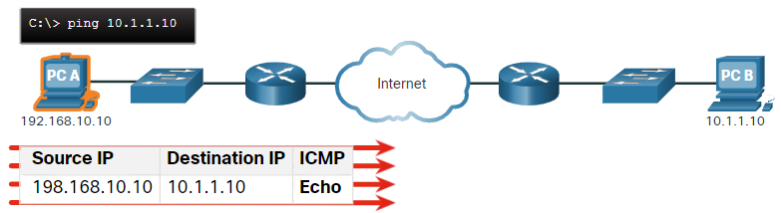
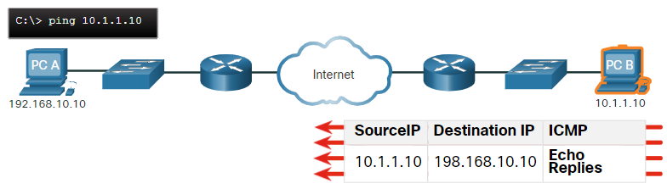
Verify Connectivity Verify Connectivity with Ping
Whether your network is small and new, or you are scaling an existing network, you will always want to be able to verify that your components are properly connected to each other and to the internet.
The ping command, available on most operating systems, is the most effective way to quickly test Layer 3 connectivity between a source and destination IP address.
The ping command uses the Internet Control Message Protocol (ICMP) echo (ICMP Type 8) and echo reply (ICMP Type 0) messages.
Notes:
17 – Build a Small Network
17.4 – Verify Connectivity
17.4.1 – Verify Connectivity with Ping

Slide 22
Verify Connectivity Verify Connectivity with Ping (Cont.)
On a Windows 10 host, the ping command sends four consecutive ICMP echo messages and expects four consecutive ICMP echo replies from the destination. The IOS ping sends five ICMP echo messages and displays an indicator for each ICMP echo reply received.
IOS Ping Indicators are as follows:
Element | Description
! | Exclamation mark indicates successful receipt of an echo reply message. It validates a Layer 3 connection between source and destination.
. | A period means that time expired waiting for an echo reply message. This indicates a connectivity problem occurred somewhere along the path.
U | Uppercase U indicates a router along the path responded with an ICMP Type 3 “destination unreachable” error message. Possible reasons include the router does not know the direction to the destination network or it could not find the host on the destination network.
Note: Other possible ping replies include Q, M, ?, or &. However, the meaning of these are out of scope for this module.
Notes:
17 – Build a Small Network
17.4 – Verify Connectivity
17.4.1 – Verify Connectivity with Ping (Cont.)

Slide 23
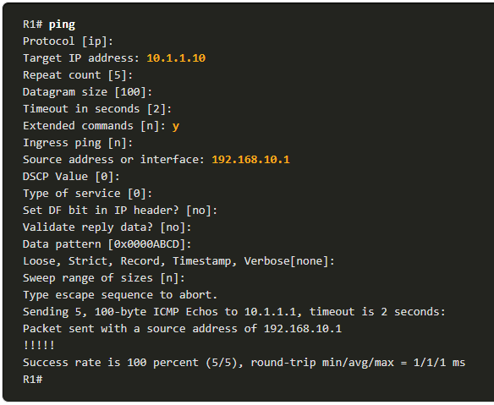
Verify Connectivity Extended Ping
The Cisco IOS offers an "extended" mode of the ping command.
Extended ping is entered in privileged EXEC mode by typing ping without a destination IP address. You will then be given several prompts to customize the extended ping.
Note: Pressing Enter accepts the indicated default values. The ping ipv6 command is used for IPv6 extended pings.
Notes:
17 – Build a Small Network
17.4 – Verify Connectivity
17.4.2 – Extended Ping

Slide 24
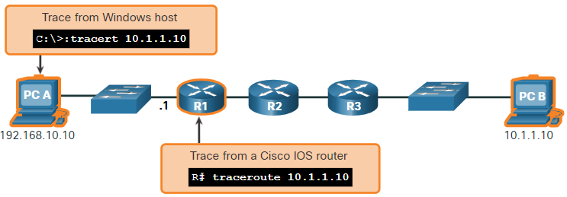
Verify Connectivity Verify Connectivity with Traceroute
The ping command is useful to quickly determine if there is a Layer 3 connectivity problem. However, it does not identify where the problem is located along the path.
Traceroute can help locate Layer 3 problem areas in a network. A trace returns a list of hops as a packet is routed through a network.
The syntax of the trace command varies between operating systems.
Notes:
17 – Build a Small Network
17.4 – Verify Connectivity
17.4.3 – Verify Connectivity with Traceroute

Slide 25
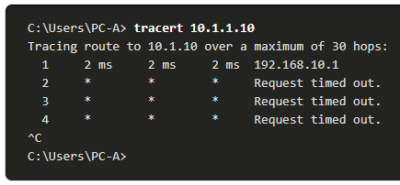
Verify Connectivity Verify Connectivity with Traceroute (Cont.)
The following is a sample output of tracert command on a Windows 10 host.
Note: Use Ctrl-C to interrupt a tracert in Windows.
The only successful response was from the gateway on R1. Trace requests to the next hop timed out as indicated by the asterisk (*), meaning that the next hop router did not respond or there is a failure in the network path. In this example there appears to be a problem between R1 and R2.
Notes:
tracert www.apu.edu.my
17 – Build a Small Network
17.4 – Verify Connectivity
17.4.3 – Verify Connectivity with Traceroute (Cont.)

Slide 26
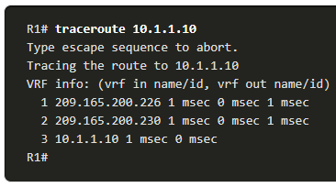
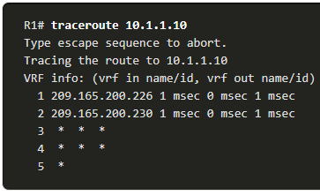
Verify Connectivity Verify Connectivity with Traceroute (Cont.)
The following are sample outputs of traceroute command from R1:
On the left, the trace validated that it could successfully reach PC B.
On the right, the 10.1.1.10 host was not available, and the output shows asterisks where replies timed out. Timeouts indicate a potential network problem.
Use Ctrl-Shift-6 to interrupt a traceroute in Cisco IOS.
Note: Windows implementation of traceroute (tracert) sends ICMP Echo Requests. Cisco IOS and Linux use UDP with an invalid port number. The final destination will return an ICMP port unreachable message.
Notes:
17 – Build a Small Network
17.4 – Verify Connectivity
17.4.3 – Verify Connectivity with Traceroute (Cont.)

Slide 27
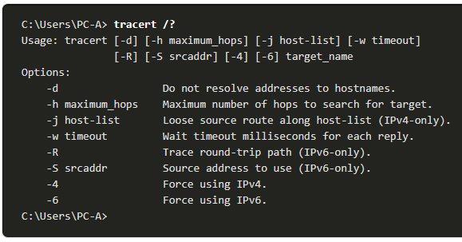
Verify Connectivity Extended Traceroute
Like the extended ping command, there is also an extended traceroute command. It allows the administrator to adjust parameters related to the command operation.
The Windows tracert command allows the input of several parameters through options in the command line. However, it is not guided like the extended traceroute IOS command. The following output displays the available options for the Windows tracert command:
Notes:
17 – Build a Small Network
17.4 – Verify Connectivity
17.4.4 – Extended Traceroute

Slide 28
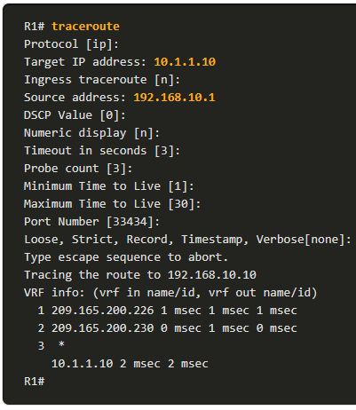
Verify Connectivity Extended Traceroute (Cont.)
The Cisco IOS extended traceroute option enables the user to create a special type of trace by adjusting parameters related to the command operation.
Extended traceroute is entered in privileged EXEC mode by typing traceroute without a destination IP address. IOS will guide you through the command options by presenting a number of prompts related to the setting of all the different parameters.
Note: Pressing Enter accepts the indicated default values.
Notes:
17 – Build a Small Network
17.4 – Verify Connectivity
17.4.4 – Extended Traceroute (Cont.)

Slide 29
Verify Connectivity Network Baseline
One of the most effective tools for monitoring and troubleshooting network performance is to establish a network baseline.
One method for starting a baseline is to copy and paste the results from an executed ping, trace, or other relevant commands into a text file. These text files can be time stamped with the date and saved into an archive for later retrieval and comparison.
Among items to consider are error messages and the response times from host to host.
Corporate networks should have extensive baselines; more extensive than we can describe in this course. Professional-grade software tools are available for storing and maintaining baseline information.
Notes:
17 – Build a Small Network
17.4 – Verify Connectivity
17.4.5 – Network Baseline

Slide 30
Host and IOS Commands
Notes:
17.0 Build a Small Network
17.5 Host and IOS Commands

Slide 31
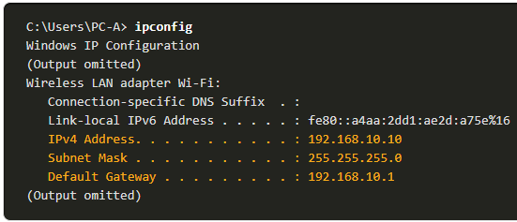
Host and IOS Commands IP Configuration on a Windows Host
In Windows 10, you can access the IP address details from the Network and Sharing Center to quickly view the four important settings: address, mask, router, and DNS. Or you can issue the ipconfig command at the command line of a Windows computer.
Use the ipconfig /all command to view the MAC address, as well as a number of details regarding the Layer 3 addressing of the device.
If a host is configured as a DHCP client, the IP address configuration can be renewed using the ipconfig /release and ipconfig /renew commands.
The DNS Client service on Windows PCs also optimizes the performance of DNS name resolution by storing previously resolved names in memory. The ipconfig /displaydns command displays all of the cached DNS entries on a Windows computer system.
Notes:
17 – Build a Small Network
17.5 - Host and IOS Commands
17.5.1 – IP Configuration on a Windows Host

Slide 32
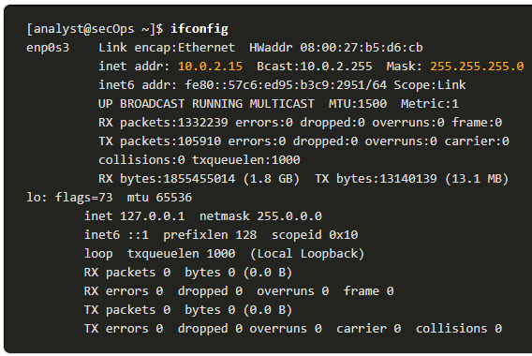
Host and IOS Commands IP Configuration on a Linux Host
Verifying IP settings using the GUI on a Linux machine will differ depending on the Linux distribution and desktop interface.
On the command line, use the ifconfig command to display the status of the currently active interfaces and their IP configuration.
The Linux ip address command is used to display addresses and their properties. It can also be used to add or delete IP addresses.
Note: The output displayed may vary depending on the Linux distribution.
Notes:
17 – Build a Small Network
17.5 - Host and IOS Commands
17.5.2 – IP Configuration on a Linux Host

Slide 33
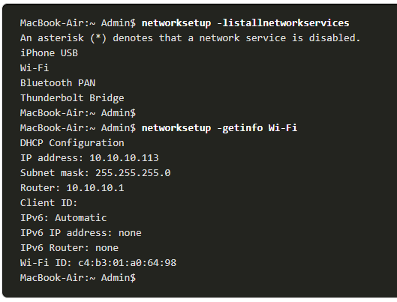
Host and IOS Commands IP Configuration on a macOS Host
In the GUI of a Mac host, open Network Preferences > Advanced to get the IP addressing information.
The ifconfig command can also be used to verify the interface IP configuration at the command line.
Other useful macOS commands to verify the host IP settings include networksetup -listallnetworkservices and the networksetup -getinfo <network service>.
Notes:
17 – Build a Small Network
17.5 - Host and IOS Commands
17.5.3 – IP Configuration on a macOS Host

Slide 34
Host and IOS Commands The arp Command
The arp command is executed from the Windows, Linux, or Mac command prompt. The command lists all devices currently in the ARP cache of the host.
The arp -a command displays the known IP address and MAC address binding. The ARP cache only displays information from devices that have been recently accessed.
To ensure that the ARP cache is populated, ping a device so that it will have an entry in the ARP table.
The cache can be cleared by using the netsh interface ip delete arpcache command in the event the network administrator wants to repopulate the cache with updated information.
Note: You may need administrator access on the host to be able to use the netsh interface ip delete arpcache command.
Notes:
17 – Build a Small Network
17.5 - Host and IOS Commands
17.5.4 – The arp Command

Slide 35
Host and IOS Commands Common show Commands Revisited
Command | Description
show running-config | Verifies the current configuration and settings
show interfaces | Verifies the interface status and displays any error messages
show ip interface | Verifies the Layer 3 information of an interface
show arp | Verifies the list of known hosts on the local Ethernet LANs
show ip route | Verifies the Layer 3 routing information
show protocols | Verifies which protocols are operational
show version | Verifies the memory, interfaces, and licenses of the device
Notes:
17 – Build a Small Network
17.5 - Host and IOS Commands
17.5.5 – Common show Commands Revisited

Slide 36
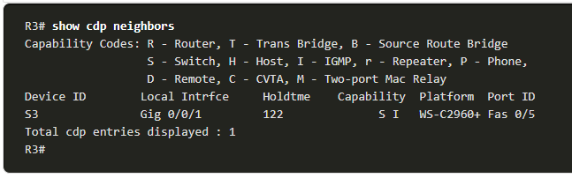
Host and IOS Commands The show cdp neighbors Command
CDP provides the following information about each CDP neighbor device:
Device identifiers - The configured host name of a switch, router, or other device
Address list - Up to one network layer address for each protocol supported
Port identifier - The name of the local and remote port in the form of an ASCII character string, such as FastEthernet 0/0
Capabilities list - Whether a specific device is a Layer 2 switch or a Layer 3 switch
Platform - The hardware platform of the device.
The show cdp neighbors detail command reveals the IP address of a neighboring device.
Notes:
17 – Build a Small Network
17.5 - Host and IOS Commands
17.5.6 – The show cdp neighbors Command

Slide 37
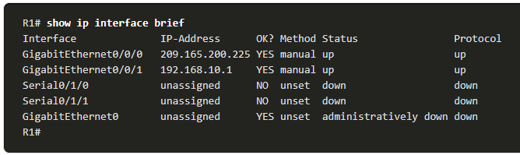
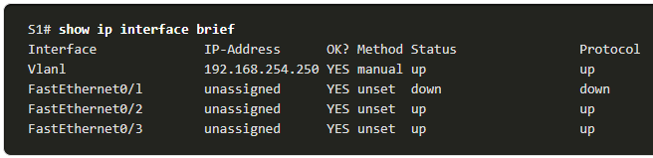
Host and IOS Commands The show ip interface brief Command
One of the most frequently used commands is the show ip interface brief command. This command provides a more abbreviated output than the show ip interface command. It provides a summary of the key information for all the network interfaces on a router.
Notes:
17 – Build a Small Network
17.5 - Host and IOS Commands
17.5.7 – The show ip interface brief Command

Slide 38
Troubleshooting Methodologies

Slide 39
Troubleshooting Methodologies Basic Troubleshooting Approaches
Step | Description
Step 1. Identify the Problem | This is the first step in the troubleshooting process. Although tools can be used in this step, a conversation with the user is often very helpful.
Step 2. Establish a Theory of Probable Causes | After the problem is identified, try to establish a theory of probable causes. This step often yields more than a few probable causes to the problem.
Step 3. Test the Theory to Determine Cause | Based on the probable causes, test your theories to determine which one is the cause of the problem. A technician may apply a quick fix to test and see if it solves the problem. If a quick fix does not correct the problem, you might need to research the problem further to establish the exact cause.
Step 4. Establish a Plan of Action and Implement the Solution | After you have determined the exact cause of the problem, establish a plan of action to resolve the problem and implement the solution.
Step 5. Verify Solution and Implement Preventive Measures | After you have corrected the problem, verify full functionality. If applicable, implement preventive measures.
Step 6. Document Findings, Actions, and Outcomes | In the final step of the troubleshooting process, document your findings, actions, and outcomes. This is very important for future reference.
Notes:
17 – Build a Small Network
17.6 – Troubleshooting Methodologies
17.6.1 – Basic Troubleshooting Approaches

Slide 40
Troubleshooting Methodologies The debug Command
The IOS debug command allows the administrator to display OS process, protocol, mechanism and event messages in real-time for analysis.
All debug commands are entered in privileged EXEC mode. The Cisco IOS allows for narrowing the output of debug to include only the relevant feature or subfeature. Use debug commands only to troubleshoot specific problems.
To list a brief description of all the debugging command options, use the debug ? command in privileged EXEC mode at the command line.
To turn off a specific debugging feature, add the no keyword in front of the debug command
Alternatively, you can enter the undebug form of the command in privileged EXEC mode.
To turn off all active debug commands at once, use the undebug all command.
Be cautious using some debug commands, as they may generate a substantial amount of output and use a large portion of system resources. The router could get so busy displaying debug messages that it would not have enough processing power to perform its network functions, or even listen to commands to turn off debugging.
Notes:
17 – Build a Small Network
17.6 – Troubleshooting Methodologies
17.6.3 – The debug Command

Slide 41
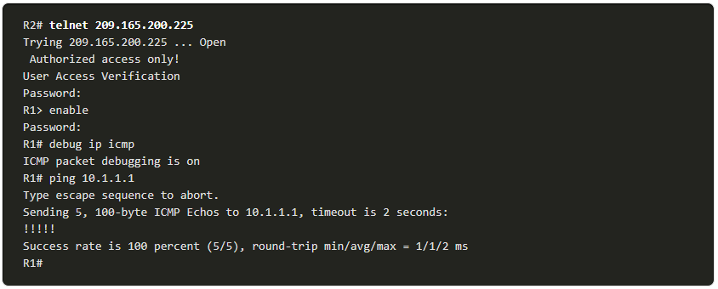
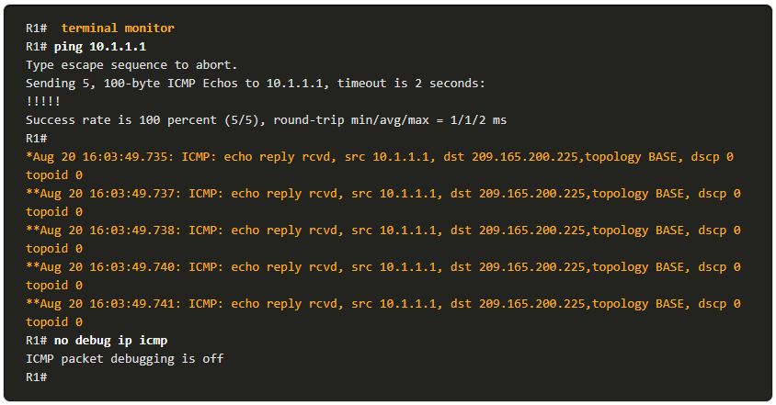
Troubleshooting Methodologies The terminal monitor Command
debug and certain other IOS message output is not automatically displayed on remote connections. This is because log messages are prevented from being displayed on vty lines.
To display log messages on a terminal (virtual console), use the terminal monitor privileged EXEC command. To stop logging messages on a terminal, use the terminal no monitor privileged EXEC command.
Notes:
17 – Build a Small Network
17.6 – Troubleshooting Methodologies
17.6.4 – The terminal monitor Command
17.6.5 – Check Your Understanding – Troubleshooting Methodologies

Slide 42
Troubleshooting Scenarios

Slide 43
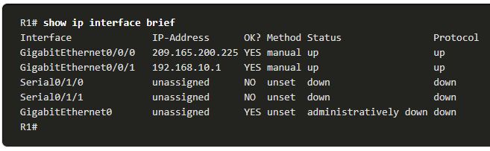
Troubleshooting Scenarios IP Addressing Issues on IOS Devices
Two common causes of incorrect IPv4 assignment are manual assignment mistakes or DHCP-related issues.
Network administrators often have to manually assign IP addresses to devices such as servers and routers. If a mistake is made during the assignment, then communications issues with the device are very likely to occur.
On an IOS device, use the show ip interface or show ip interface brief commands to verify what IPv4 addresses are assigned to the network interfaces. For example, issuing the show ip interface brief command as shown would validate the interface status on R1.
Notes:
17 – Build a Small Network
17.7 – Troubleshooting Scenarios
17.7.2 – IP Addressing Issues on IOS Devices

Slide 44
Troubleshooting Scenarios IP Addressing Issues on End Devices
On Windows-based machines, when the device cannot contact a DHCP server, Windows will automatically assign an address belonging to the 169.254.0.0/16 range. This feature is called Automatic Private IP Addressing (APIPA).
A computer with an APIPA address will not be able to communicate with other devices in the network because those devices will most likely not belong to the 169.254.0.0/16 network.
Note: Other operating systems, such Linux and OS X, do not use APIPA.
If the device is unable to communicate with the DHCP server, then the server cannot assign an IPv4 address for the specific network and the device will not be able to communicate.
To verify the IP addresses assigned to a Windows-based computer, use the ipconfig command.
Notes:
17 – Build a Small Network
17.7 – Troubleshooting Scenarios
17.7.3 – IP Addressing Issues on End Devices

Slide 45
Troubleshooting Scenarios Default Gateway Issues
The default gateway for an end device is the closest networking device, belonging to the same network as the end device, that can forward traffic to other networks. If a device has an incorrect or nonexistent default gateway address, it will not be able to communicate with devices in remote networks.
Similar to IPv4 addressing issues, default gateway problems can be related to misconfiguration (in the case of manual assignment) or DHCP problems (if automatic assignment is in use).
To verify the default gateway on Windows-based computers, use the ipconfig command.
On a router, use the show ip route command to list the routing table and verify that the default gateway, known as a default route, has been set. This route is used when the destination address of the packet does not match any other routes in its routing table.
Notes:
17 – Build a Small Network
17.7 – Troubleshooting Scenarios
17.7.4 – Default Gateway Issues

Slide 46
Summary
Notes:
4-Physical Layer
4.8 - Summary

Slide 47

Summary / Recap of Main Points

Slide 48
Q & A

Slide 49
What To Expect Next Week
In Class
Revision

